Slide 1
MBTI Game

Slide 2
Common Instructions to all Teams
45 minutes: Discussions ( Make Notes !!)
15 minutes: Chart Making with details
Presentation BY GROUP: 5 minutes
What is your plan/ decision/ information?
How was the discussion in your Team?
What were the easy points of agreement?
What were the hard points that led to disagreement?

Slide 3
Team 1
Plan your perfect house party

Slide 4
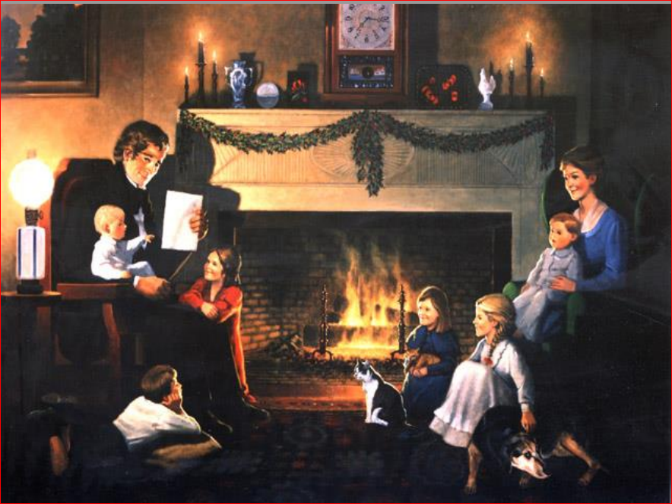
Team 2 Look at the Picture and write what you see

Slide 5
Team 3
Plan a summer-long trip to Europe.

Slide 6
Team 4
You are hiring someone for a job.
One candidate had a perfect resume and interview.
The other candidate was not as outstanding as the first, however the second candidate is a single parent and really needs a job.
You can only hire one person.
Whom do you hire and why?

Slide 8
Teams and Tasks
Team 1: Party: E vs I
Team 2: Picture: S vs N
Team 3: Vacation: T vs F
Team 4: Recruitment: J vs P

Slide 9
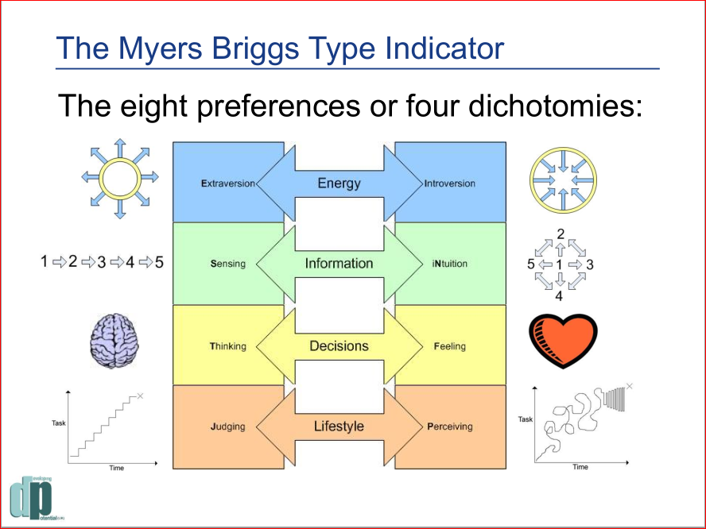
Our Preferences

